Slide 1
Result Summary
7/28/2021

Slide 2
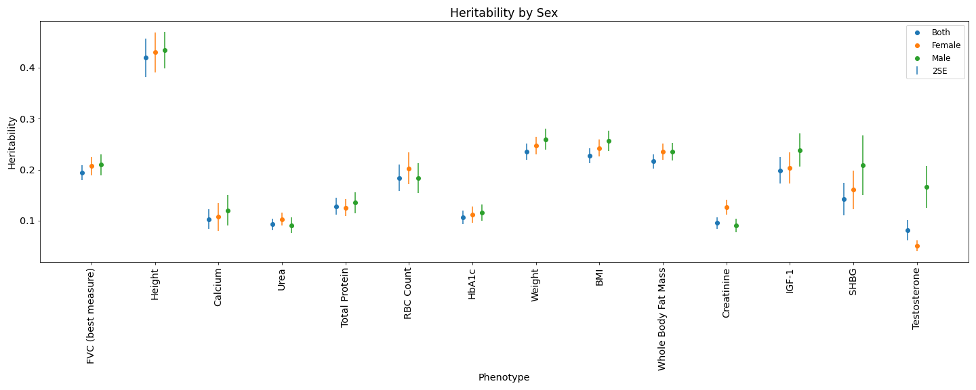
Heritability by Sex

Slide 3
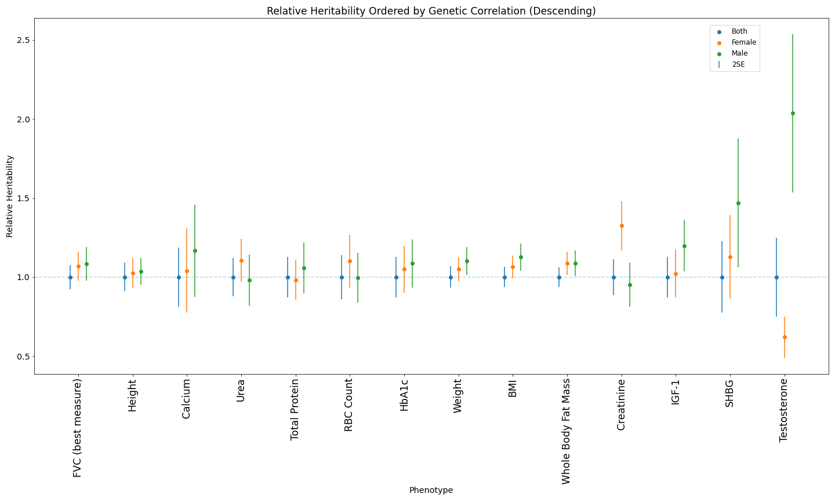
Relative Heritability Ordered by Genetic Correlation (Descending)

Slide 4
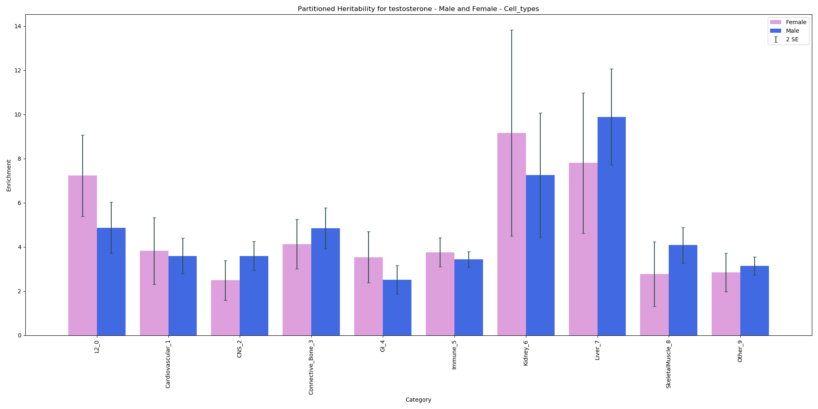
Partitioned Heritability – Cell Types - Testosterone

Slide 5
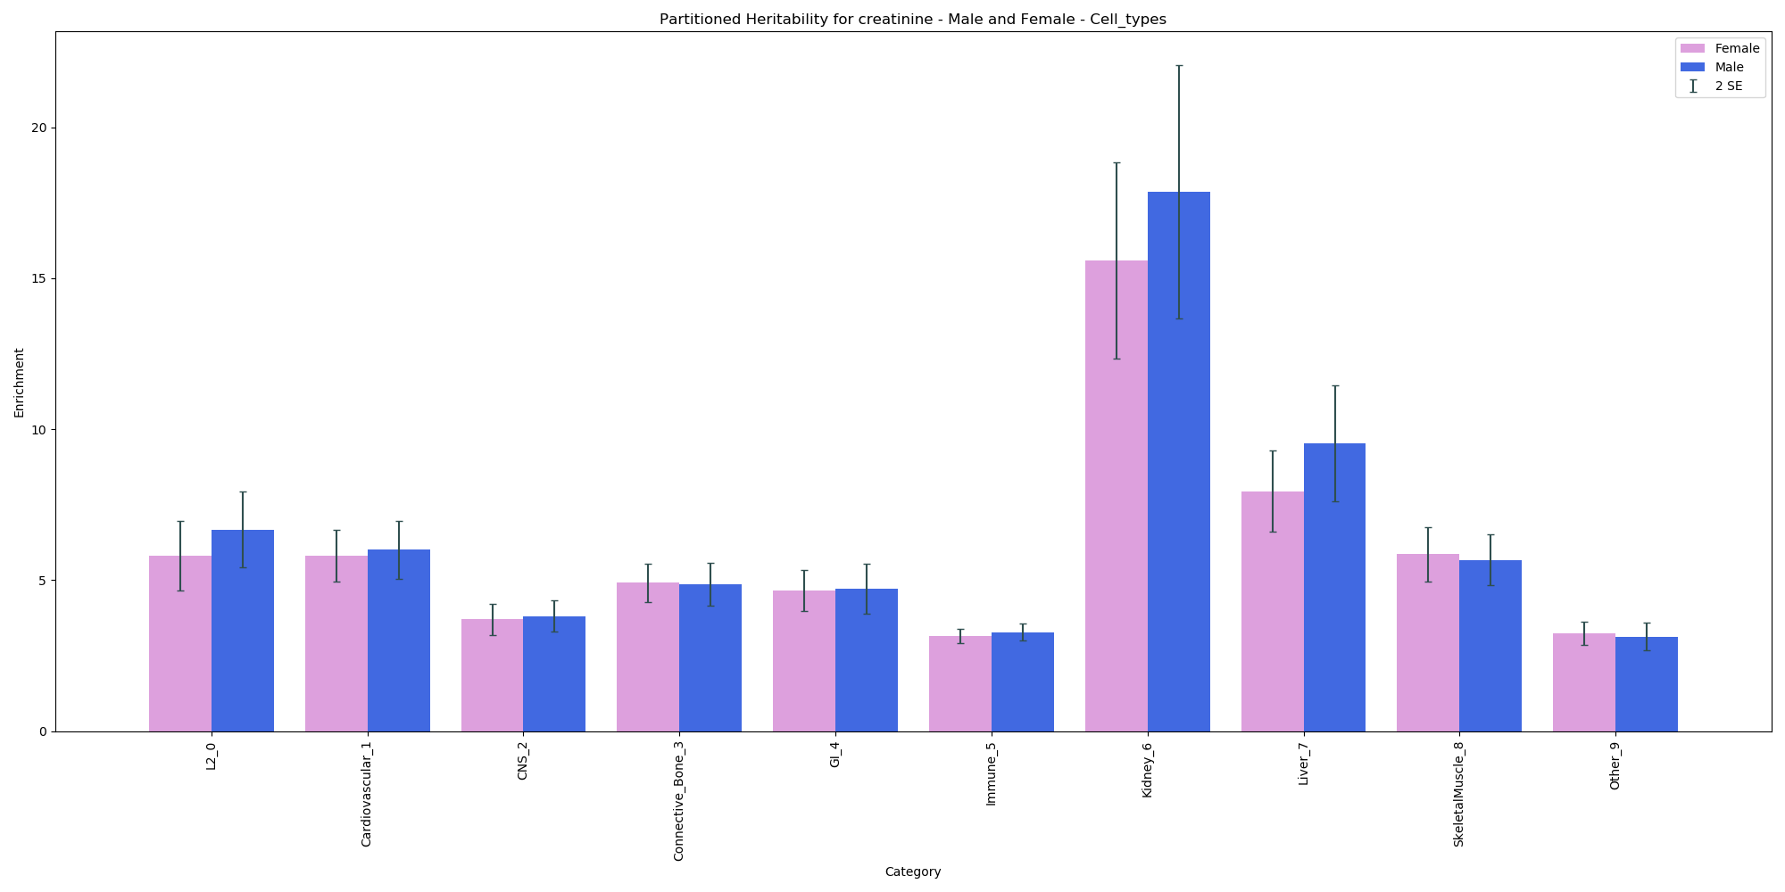
Partitioned Heritability – Cell Types - Creatinine

Slide 6
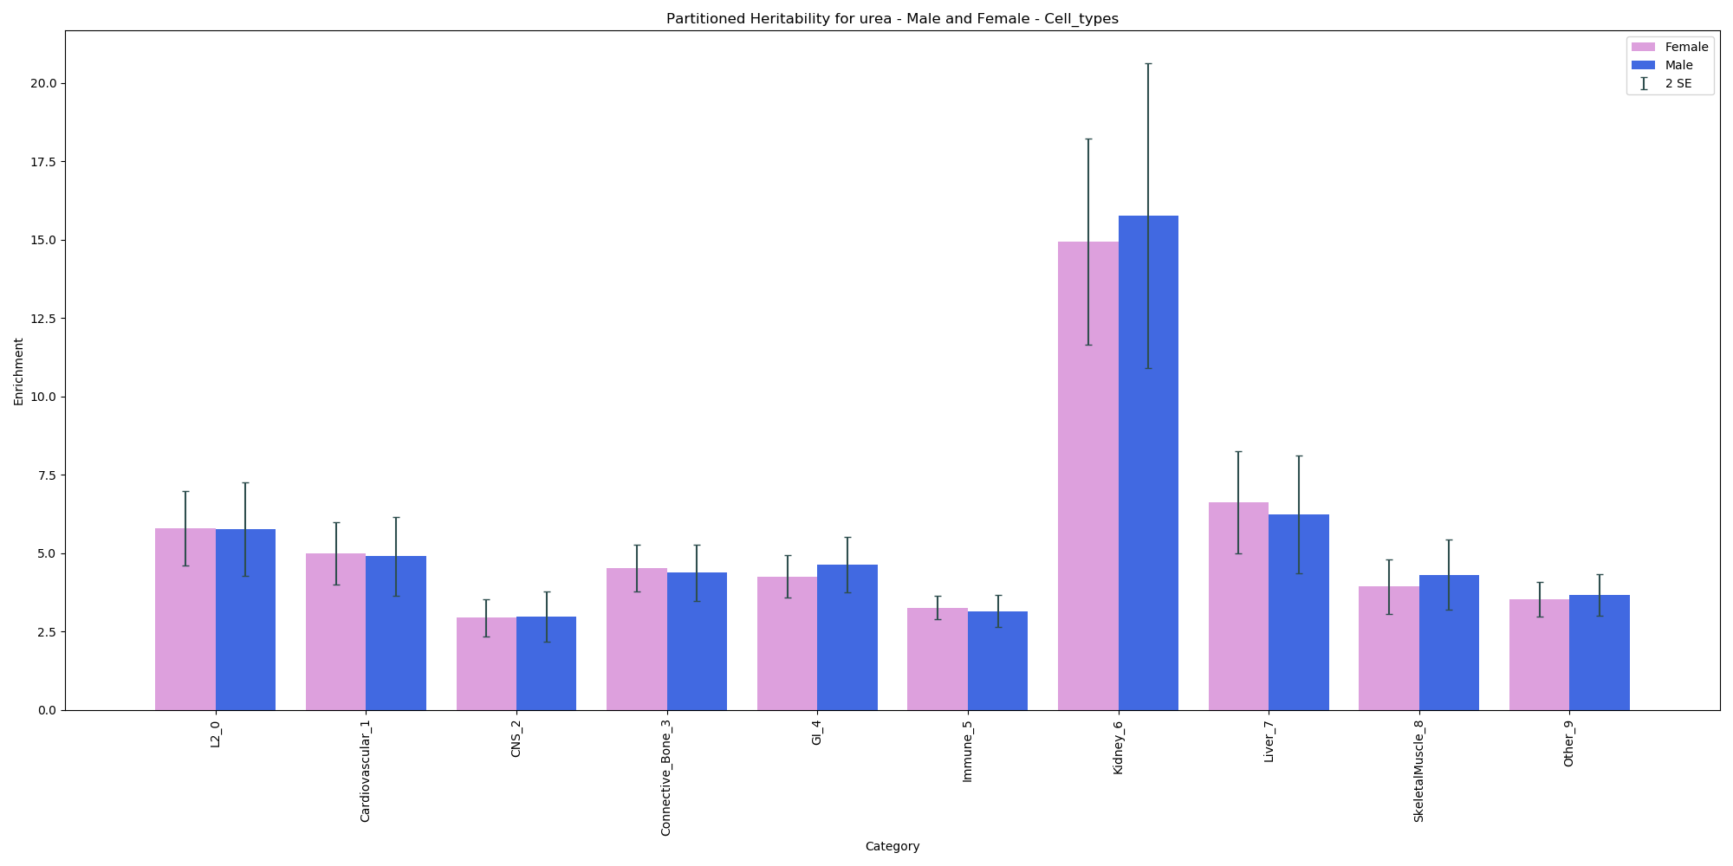
Partitioned Heritability – Cell Types - Urea

Slide 7
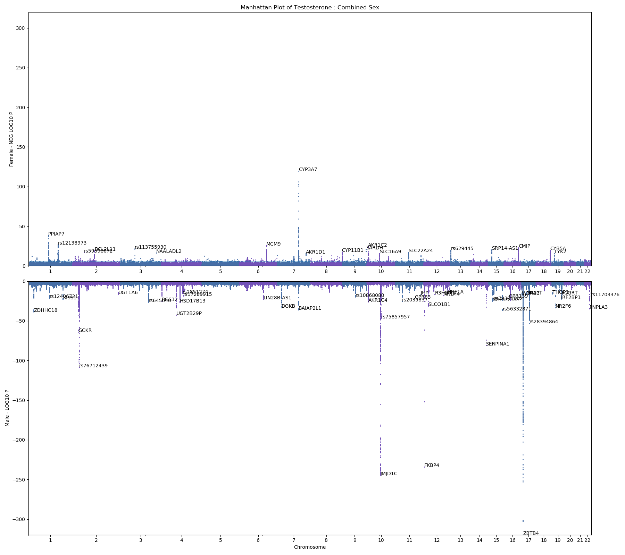
Manhattan Plot - Testosterone

Slide 8
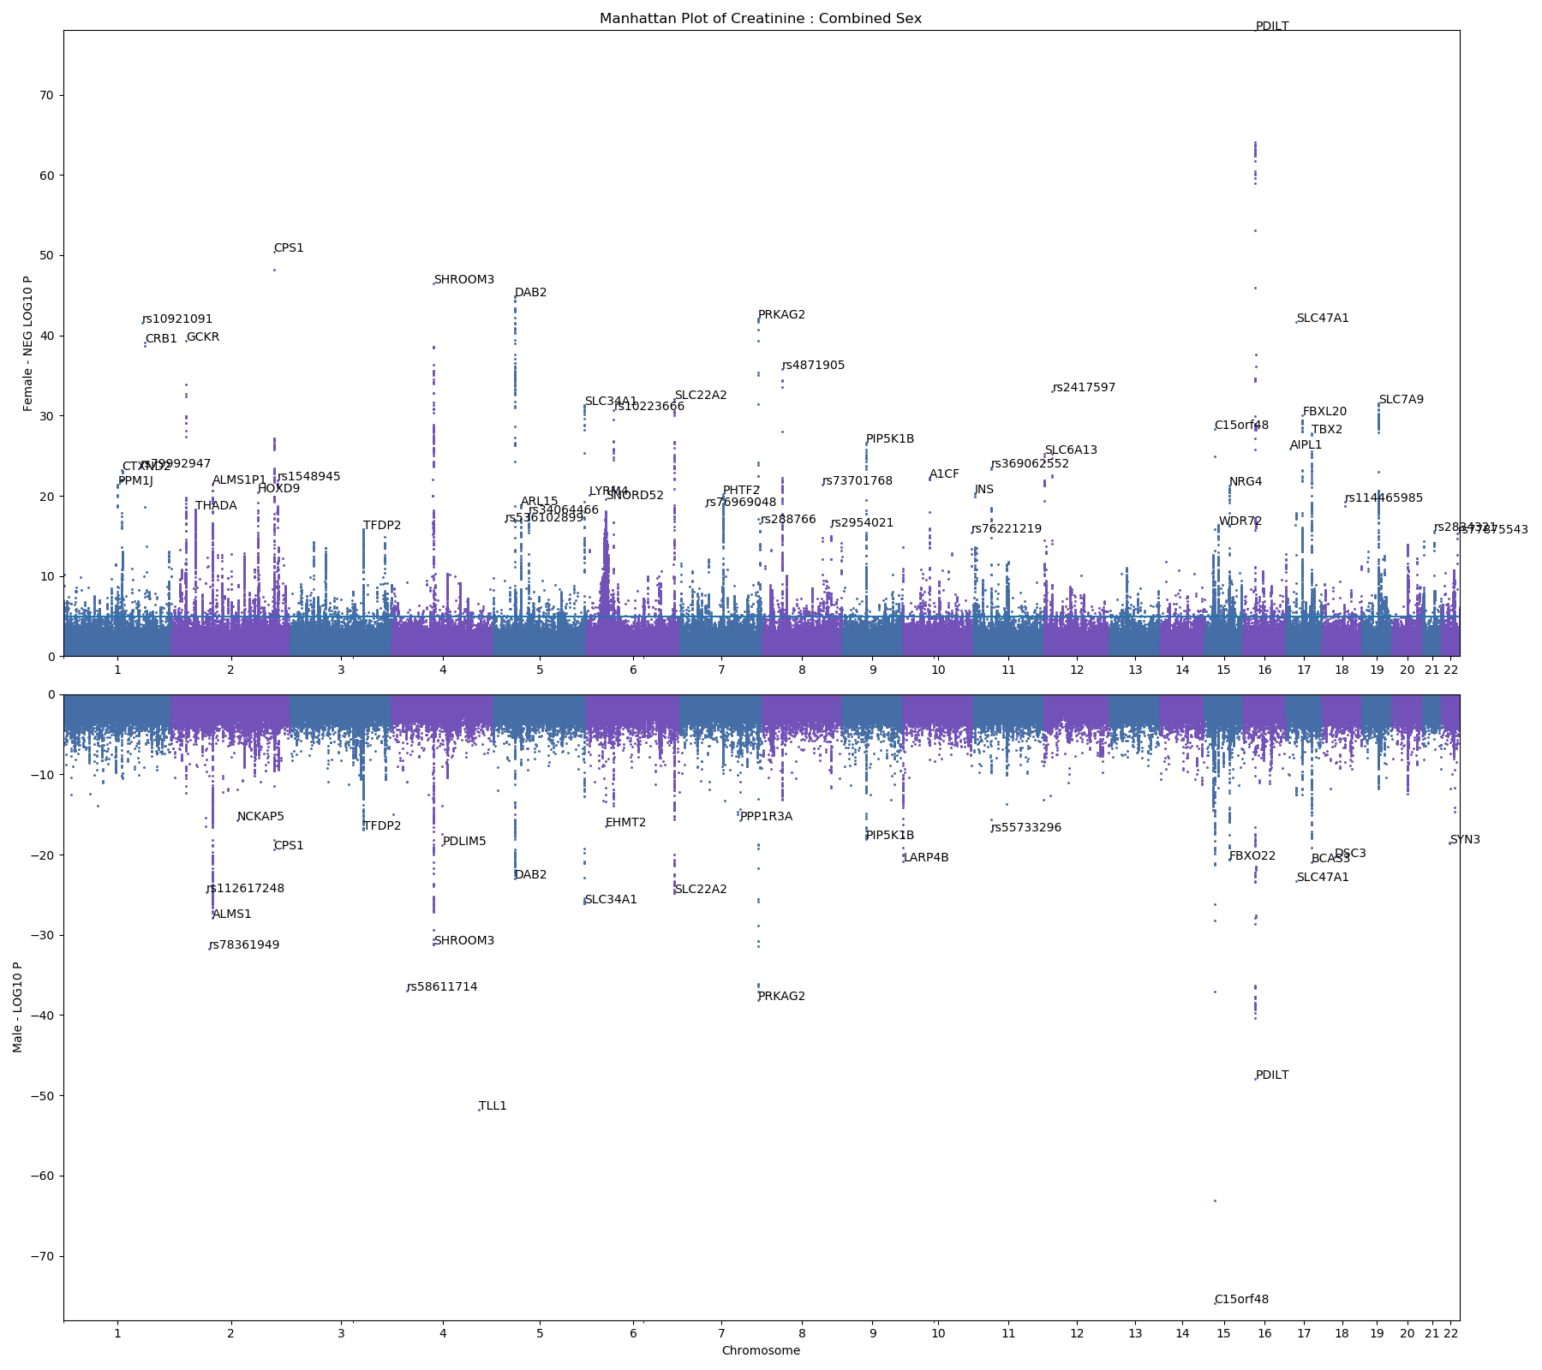
Manhattan Plot - Creatinine

Slide 9
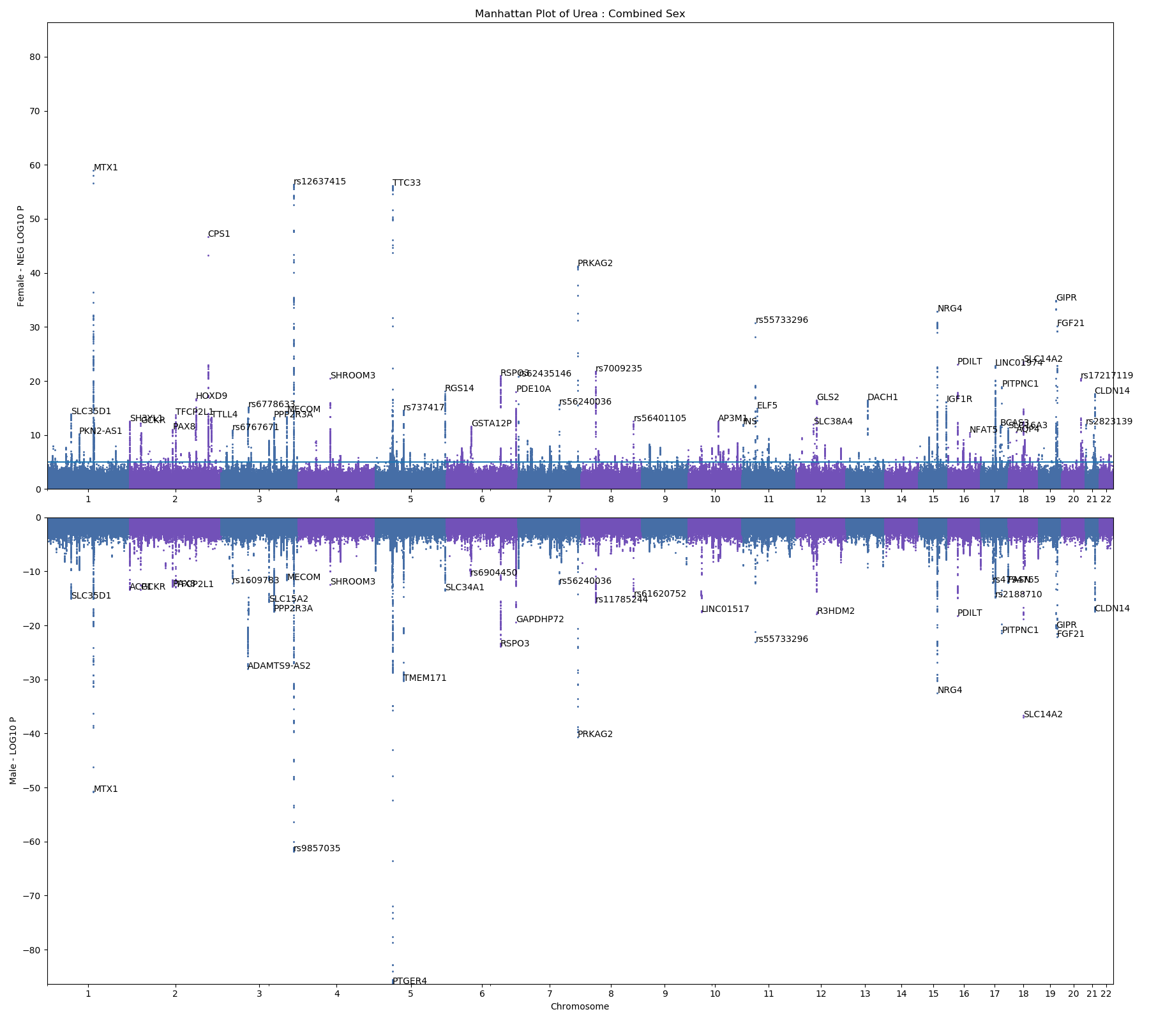
Manhattan Plot - Urea

Slide 10
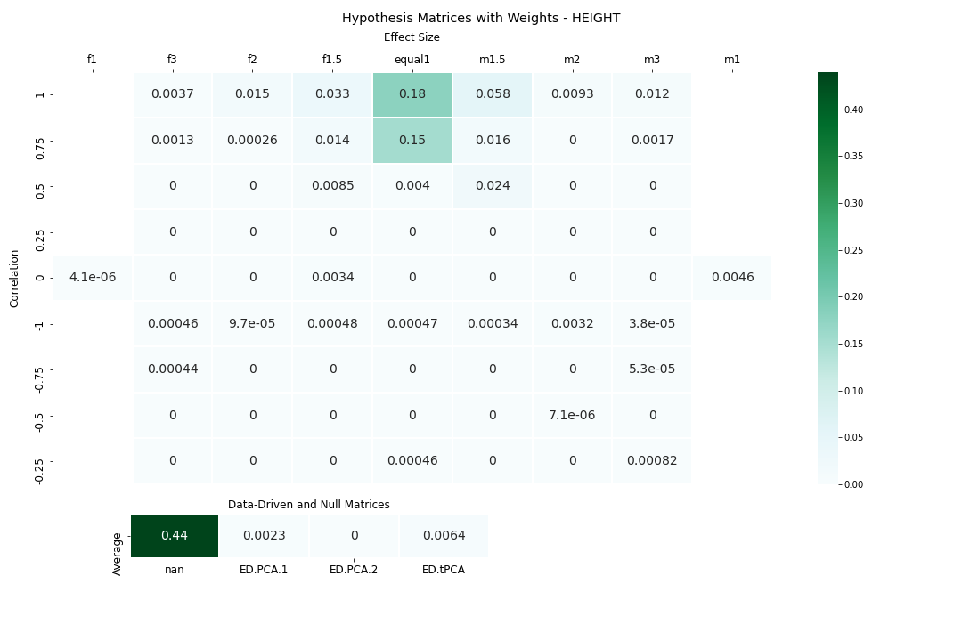
mash - height

Slide 11
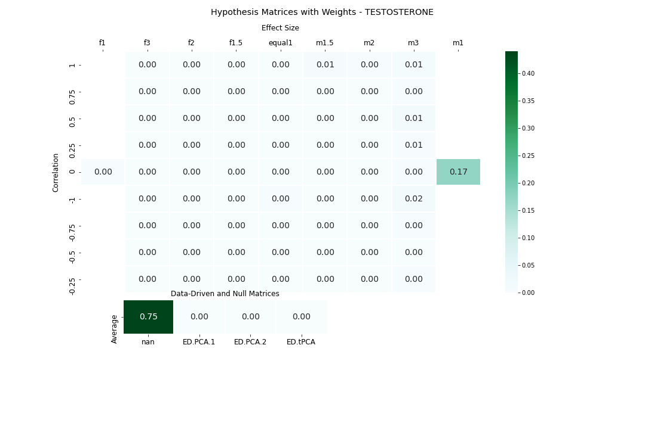
mash - testosterone

